Slide 1
CN-UPB/PG : Artificial Intelligence for Computer Networks
Seminar Paper:
Resource Management With Deep
Reinforcement Learning

Slide 2
Contents
Resource Management Challenges and Scopes of Reinforcement Learning
Proposed Model : DeepRM
Training Algorithm
Comparison
Convergence of DeepRM
Performance Gain
Limitation
Future Work
References

Slide 3
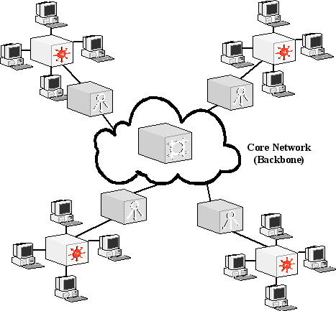

Resource Management Challenges and Scopes of Reinforcement Learning
Online decision making under massive workload
Dynamic and complex models
Interdependency between tasks
Alternative to general heuristics
Figure 1 : Cluster computing [1]
Repetitive decisions provide abundant training data
Deep NN to model complex systems
RL agent can be trained to optimize system objectives
Figure 2 : Reinforcement Learning model [2]

Slide 4
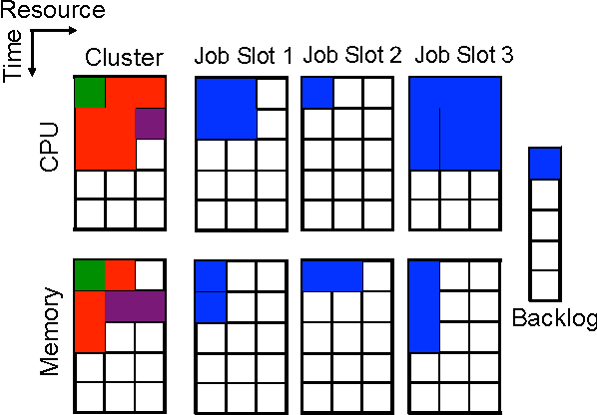
Proposed Model: DeepRM
RL Formulation
1. State Representation
3. System Objective and Reward
2. Action Space,
A= { ∅, 1,… M}
Figure 3 : State representation [3]
1
Minimize average job slowdown
Reward function,
$$\sum_{j∈J}{\frac{−1}{T_{j}}}$$
Reward function,
∑_(𝒋∈𝑱)▒(−𝟏)/𝑻_𝒋
2
Minimize average job completion time
Reward function,
-$\left| J \right|$
Reward function,
- | 𝑱 |

Slide 5
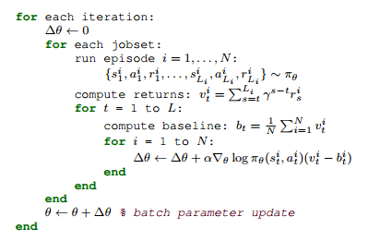
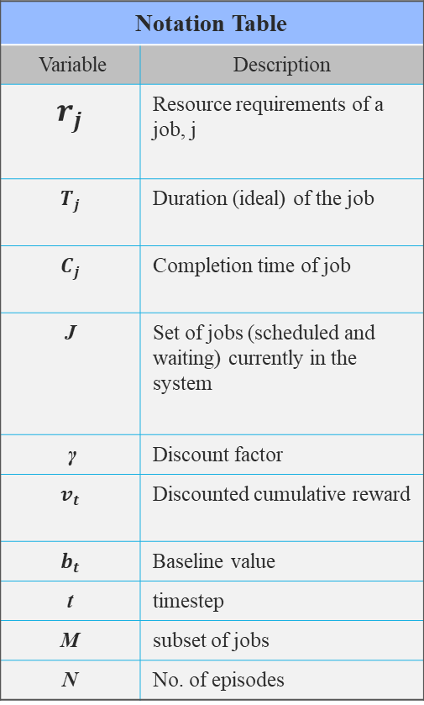
Training Algorithm
Notation Table
Variable | Description
$$r_{j}$$ | Resource requirements of a job, j
$$T_{j}$$ | Duration (ideal) of the job
$$C_{j}$$ | Completion time of job
J | Set of jobs (scheduled and waiting) currently in the system
γ | Discount factor
$$v_{t}$$ | Discounted cumulative reward
$$b_{t}$$ | Baseline value
t | timestep
M | subset of jobs
N | No. of episodes
Figure 4 : Policy training algorithm [3]

Slide 6
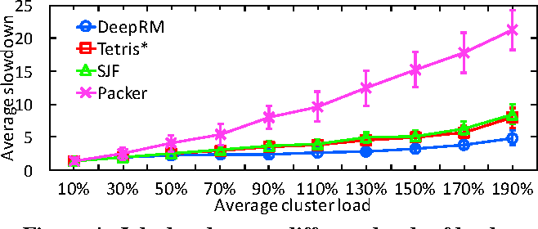
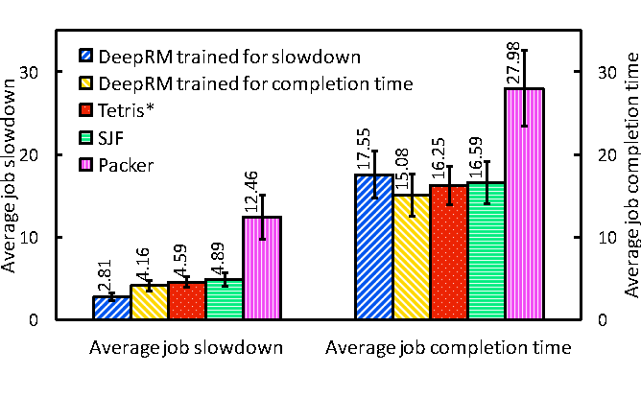
Comparison
Comparables :
a DeepRM agent
a Shortest Job First agent
a Packer agent
A Tetris agent [4]
DeepRM is customizable for different objectives!
Figure 5 : Average job slowdown at different levels [3]
Experimental parameters
M = 10
N = 20
Training iterations = 1000
Learning rate= .001
γ = 1
Figure 6 : Performance for different objectives [3]

Slide 7
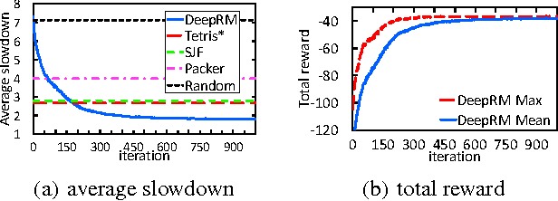
Convergence of DeepRM
Large gap between max and average value indicates the need for further learning
After 200 iteration, DeepRM beats Tetris
Figure 7 : Learning curve showing the slowdown and the
total reward performance [3]

Slide 8
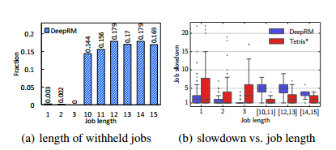
Performance Gain
Figure 8 : Performance gain of DeepRM by withholding large jobs [3]
DeepRM learns to withhold large jobs
Slowdown for small jobs is significantly smaller with DeepRM than Tetris

Slide 9
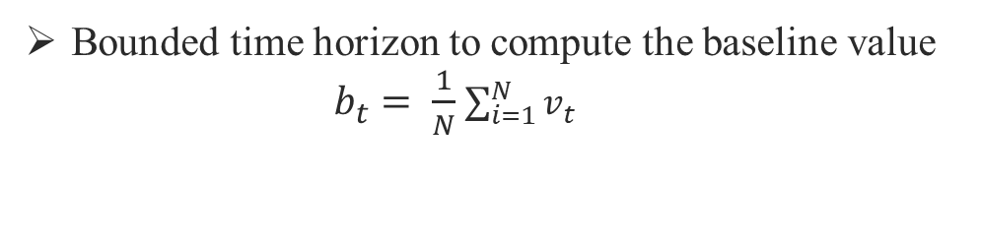
Limitation
Overlooking machine boundaries and resource fragmentation
Data local allocations
Inter task dependency matters in real world
Bounded time horizon to compute the baseline value
$b_{t}= \frac{1}{N}$ $\sum_{i=1}^{N}{v_{t}^{}}$

Slide 10
Future Work
Guiding the agent towards data local allocations with appropriate
reward function
Use of value network to compute the baseline

Slide 11
References
[ 1 ] Yu, Lean & Wang, Shouyang & Lai, Kin Keung & Wu, Yue. (2005). A framework of
Web-based text mining on the grid. 2005. 6 pp.-. 10.1109/NWESP.2005.3.
[ 2 ] https://www.kdnuggets.com/2018/03/5-things-reinforcement-learning.html
[ 3 ] H. Mao, M. Alizadeh, I. Menache, and S. Kandula, “Resource Management with Deep
Reinforcement Learning,” Proceedings of the 15th ACM Workshop on Hot Topics in
Networks, pp. 50–56, 2016.
[ 4 ] R. Grandl, G. Ananthanarayanan, S. Kandula, S. Rao, and A. Akella. "Multi-resource
Packing for cluster schedulers," Proceedings of the 2014 ACM Conference on SIGCOMM,
pp. 455–466, 2014.

Slide 12
Thank You !

